Slide 1
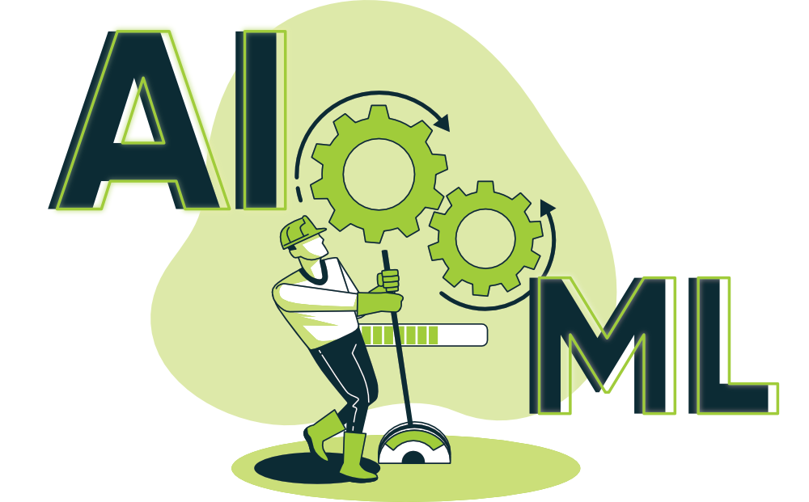
Artificial Intelligence and Machine Learning
TEXTBOOKS/LEARNING RESOURCES:
a) T. M. Mitchell, Machine Learning (1st ed.), McGraw Hill, 2017. ISBN 978-1259096952.
b) E. Alpaydin, Introduction to Machine Learning (4th ed.), Phi, 2020. ISBN 978-8120350786
REFERENCE BOOKS/LEARNING RESOURCES:
a) Oswald Campesato, Artificial Intelligence, Machine Learning, and Deep Learning (1st ed.), Mercury Learning & Information, 2020. ISBN 9781683924665.

Slide 2
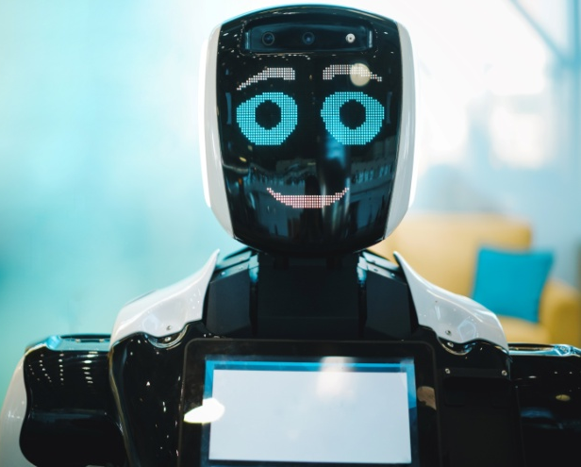

Application in Different
Specializations Domains?
Artificial Intelligence:
Natural Language Processing (NLP).
Computer Vision for object detection.
Reinforcement Learning for optimizing control systems.
AI-powered recommendation systems for personalized content suggestions.
Cloud Computing:
AI-based resource allocation and workload optimization in cloud infrastructure.
Anomaly detection to identify unusual activities and potential security breaches.
Predictive maintenance for cloud servers and data centers.

Slide 3


Application in Different
Specializations Domains?
Blockchain:
AI for analyzing and improving blockchain consensus protocols.
Smart contracts with AI components for self-executing agreements.
ML-based fraud detection and security enhancement in blockchain networks.
Cyber Security:
AI-powered threat detection and intrusion prevention systems.
ML for analyzing patterns of cyber attacks and identifying potential vulnerabilities.
Anomaly detection to identify unusual behavior in network traffic or user activities.

Slide 4
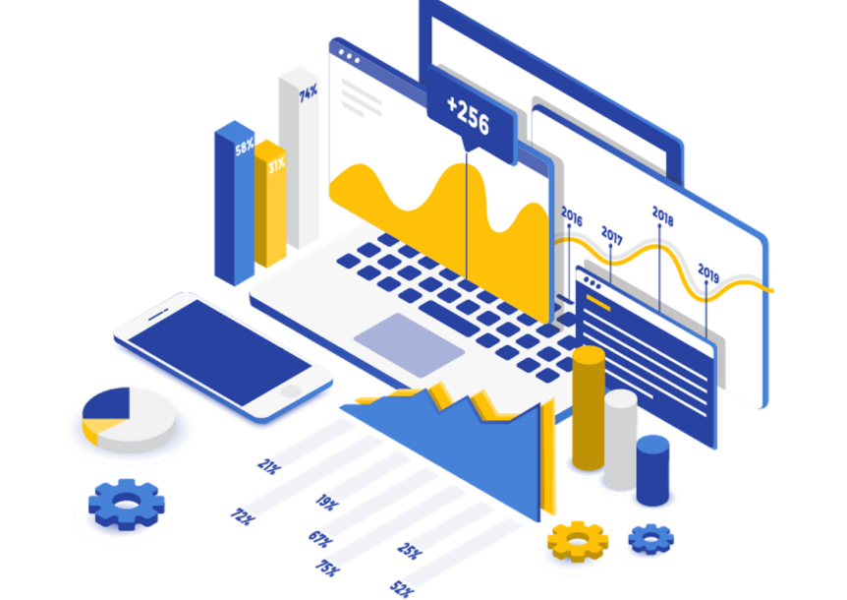

Application in Different
Specializations Domains?
Data Science:
Predictive modeling and forecasting based on large datasets.
AI-driven data analysis to extract valuable insights and patterns from complex data.
Automated data cleaning and preprocessing using AI techniques
Gaming:
AI opponents and NPCs (Non-Player Characters) with adaptive behaviors and decision-making.
Content generation to create dynamic game environments.
AI-based game testing and debugging to identify potential issues in real-time.

Slide 5
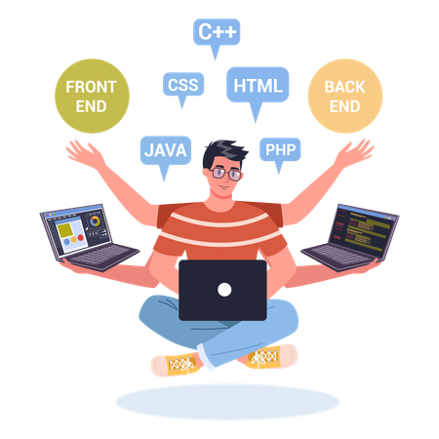
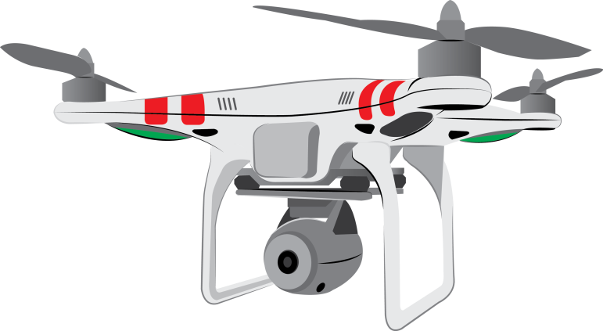
Application in Different
Specializations Domains?
Full Stack:
AI-powered personalization in web applications to enhance user experience.
ML for predictive analytics and recommendations in e-commerce platforms.
Smart chatbots and virtual assistants for customer support.
Drones:
AI-based object detection and tracking for autonomous navigation.
ML for optimizing flight paths and improving battery efficiency.
Computer vision and AI-enabled payload analysis for specific applications

Slide 6
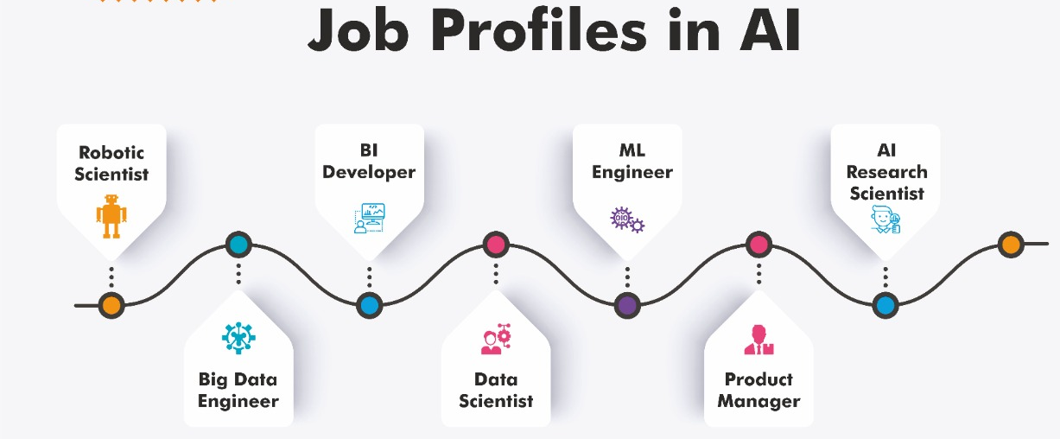

Slide 7
Lecture - 1
Machine Learning
Types of Machine Learning
Supervised Learning
Unsupervised Learning
Reinforcement Learning
Domains/Application Areas

Slide 8





Machine Learning (ML)
“Machine Learning is a branch of artificial intelligence that develops algorithms by learning the hidden patterns of the datasets used it to make predictions on new similar type data, without being explicitly programmed for each task.”
ML is a subset of artificial intelligence (AI) that uses mathematical models of data to help a computer learn without direct instruction.
ML uses algorithms to identify patterns within data, and those patterns are then used to create a data model that can make predictions.
The adaptability of ML makes it a great choice in dynamic scenarios (where the data is always changing).

Slide 9

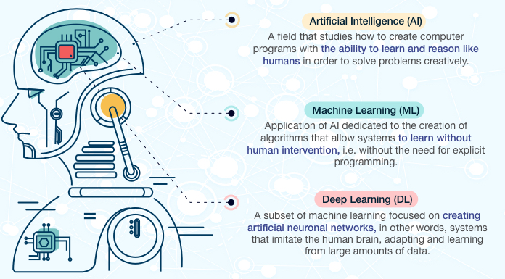
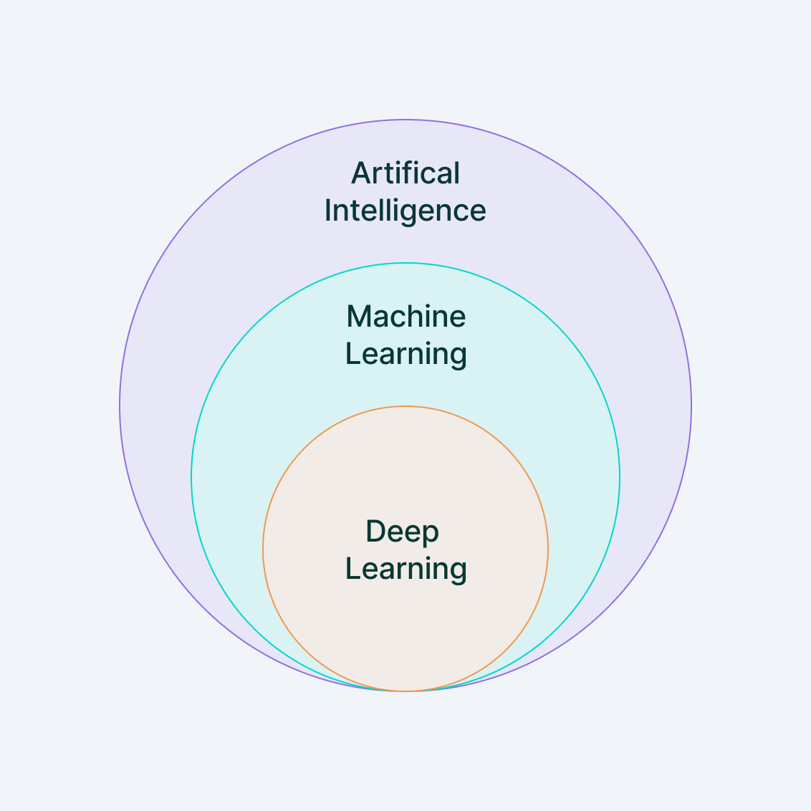
Machine Learning (ML)
1
1
2
2
3
3

Slide 10
Machine Learning (ML): Why Machine Learning ?
Human can learn from experience ------- Can machine also learn from experience
??
Humans have limitations (but one can scale-up the machines as needed)
Work 24x7
Can perform complex computational task that human can not
In emergency situations like pandemic, wars, etc.

Slide 11
Machine Learning (ML):
The term machine learning was first introduced by Arthur Samuel in 1959 . We can define it in a summarized way as:
Machine learning enables a machine to automatically learn from data, improve performance from experiences, and predict things without being explicitly programmed.
With the help of sample historical data, which is known as training data , machine learning algorithms build a mathematical model that helps in making predictions or decisions without being explicitly programmed.
Machine learning brings computer science and statistics together for creating predictive models.
Machine learning constructs or uses the algorithms that
learn from historical data.

Slide 12
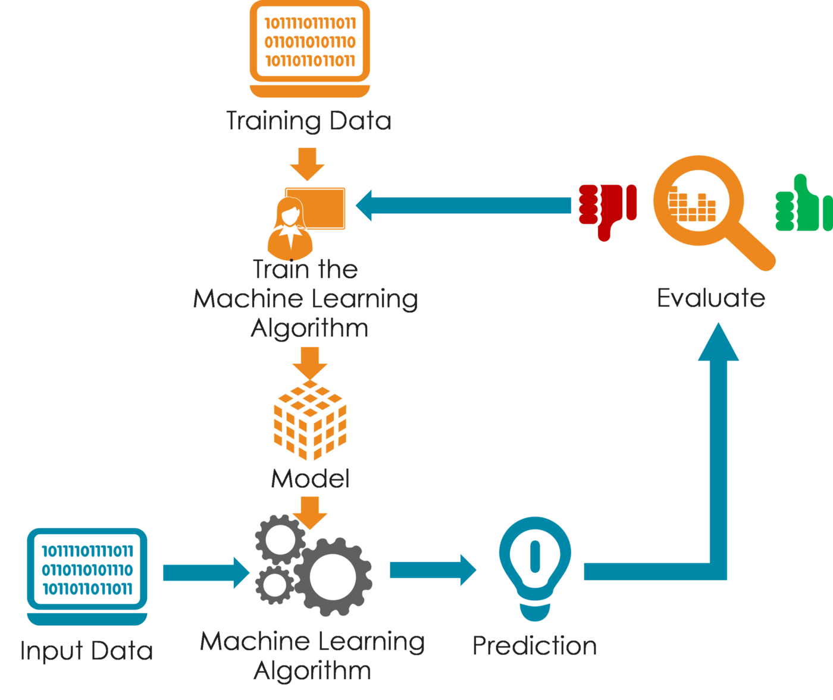
Machine Learning (ML): Process

Slide 13
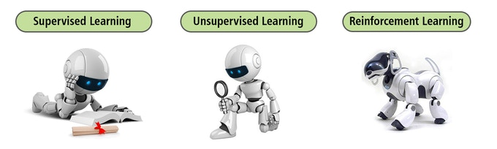
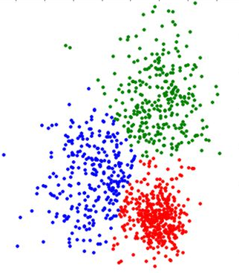
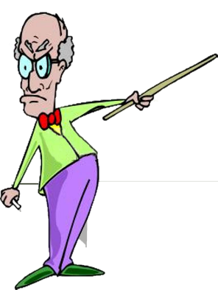
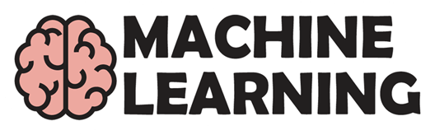
Machine Learning (ML): Types of Machine Learning
Unsupervised Learning
No labeled data is present, machine draw inferences from datasets and assign them class labels.
Supervised Learning
The machine learns from training data and labels and make predictions.
Reinforcement Learning
The machine learns on its own, receiving rewards and punishments and determining from these what it should do.

Slide 14
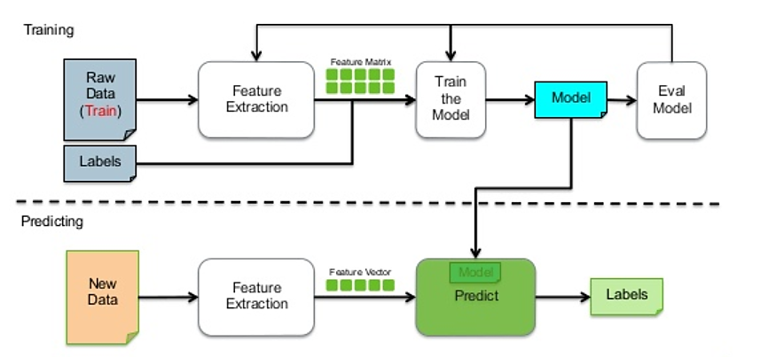
Machine Learning (ML): Supervised Learning
Supervised Learning
Examples:
Support vector machines (SVM), Neural networks, Naïve Bayes classifier, Decision trees, K-Nearest neighbors (kNN)

Slide 15
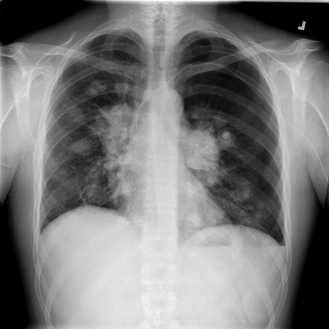
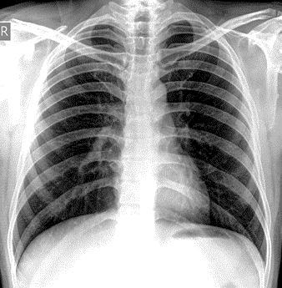
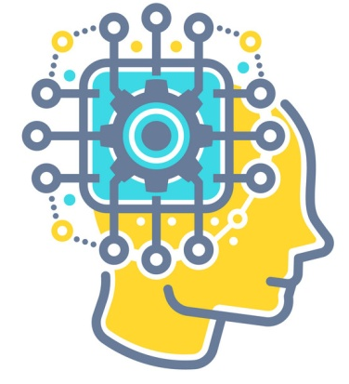
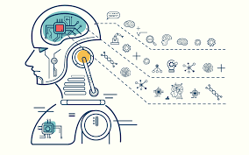
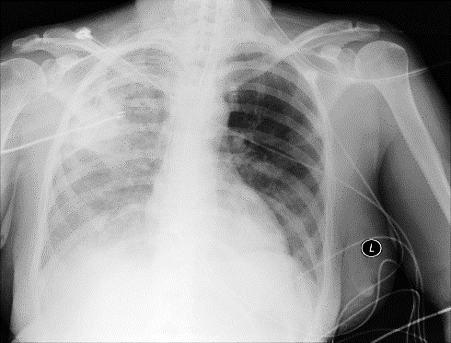
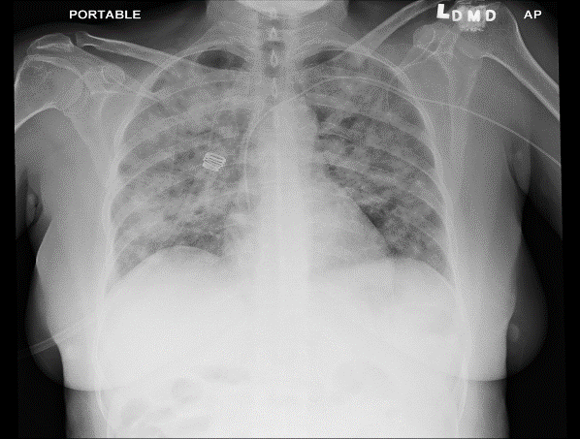


Machine Learning (ML): Supervised Learning Real-Life Example
Train Model
Trained Model
Normal
Normal X-ray Images
Abnormal
Preprocess
Extract Features
Select Optimal Features
Perform Classification
Evaluate Model Performance
Test Cases
X-ray Images of Pneumonia

Slide 16
Machine Learning (ML): Supervised Learning
Supervised learning is a type of machine learning method in which we provide sample labelled data to the machine learning system in order to train it, and on that basis, it predicts the output.
The system creates a model using labelled data to understand the datasets and learn about each data, once the training and processing are done then we test the model by providing a sample data to check whether it is predicting the exact output or not.
The goal of supervised learning is to map input data with the output data.
The supervised learning is based on supervision, and it is the same as when a student learns things in the supervision of the teacher. The example of supervised learning is spam filtering.
Supervised learning can be grouped further in two categories of algorithms: Classification and Regression

Slide 17
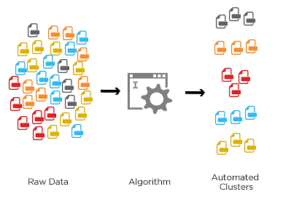
Machine Learning (ML): Unsupervised Learning
Unsupervised Learning
Examples:
K-means clustering,
Fuzzy c-means clustering
Hierarchical clustering
Density based clustering

Slide 18
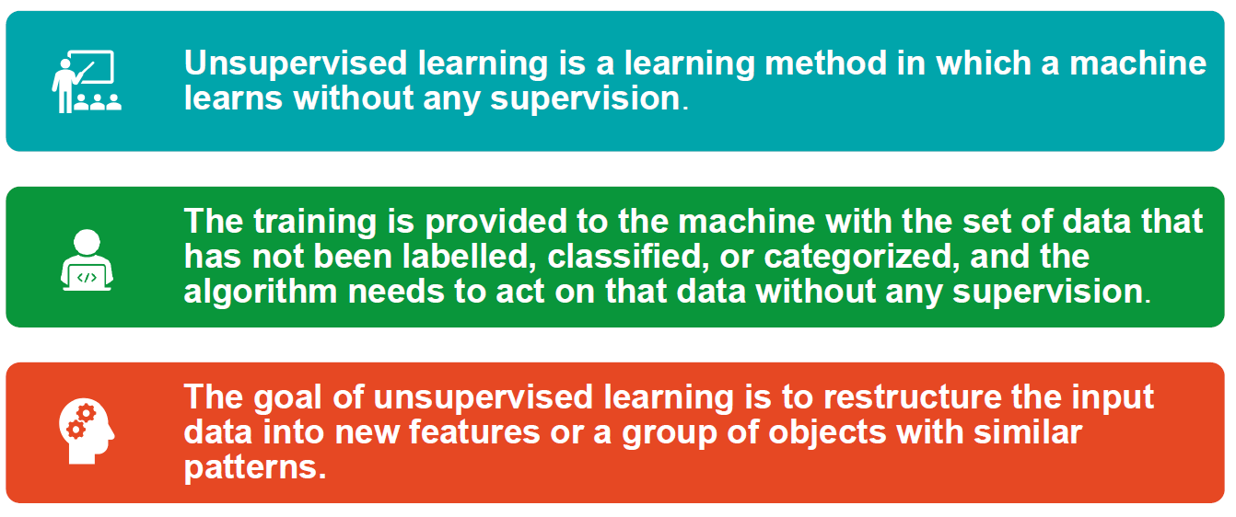
Machine Learning (ML): Unsupervised Learning

Slide 19
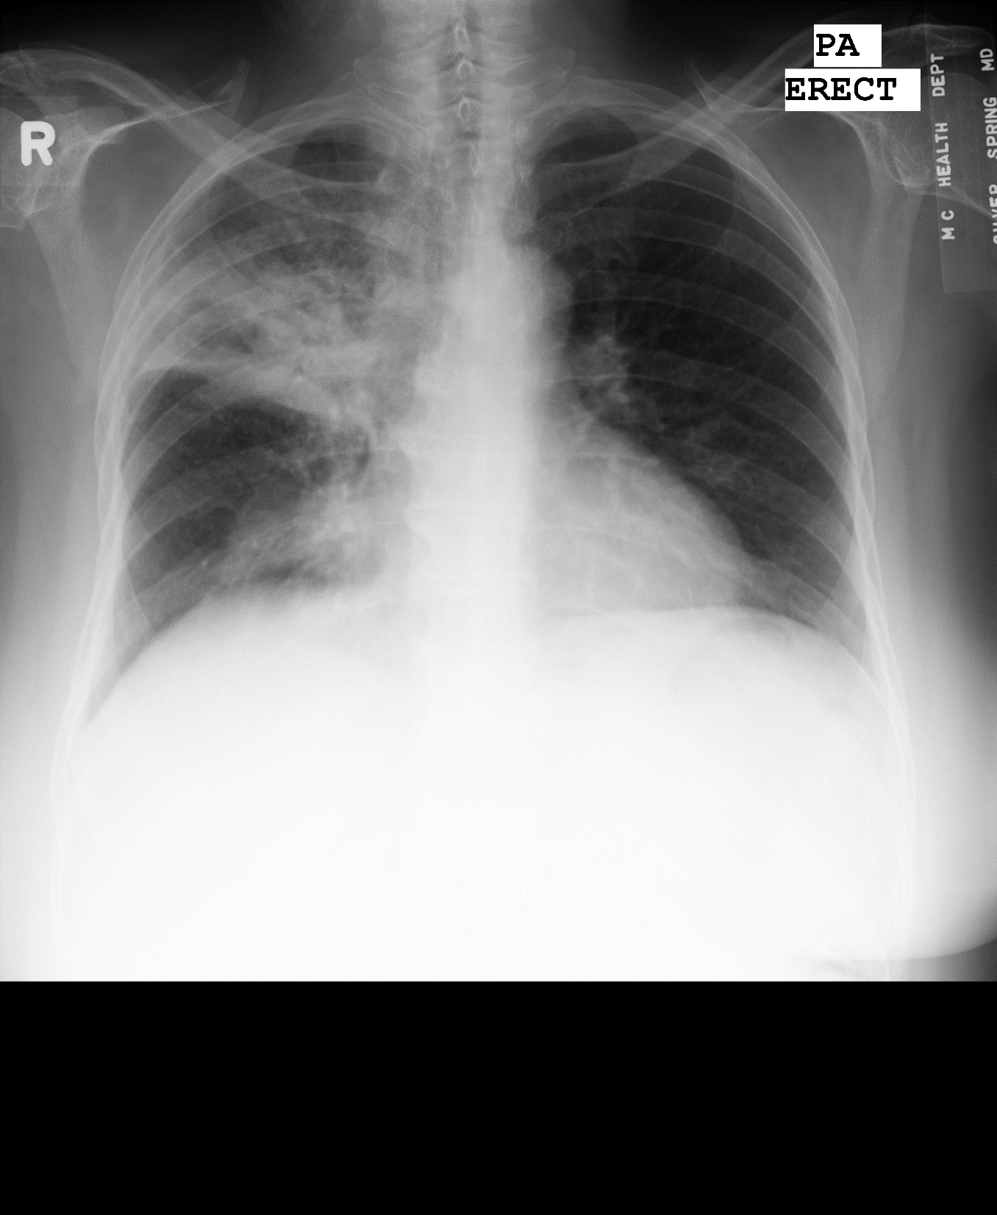
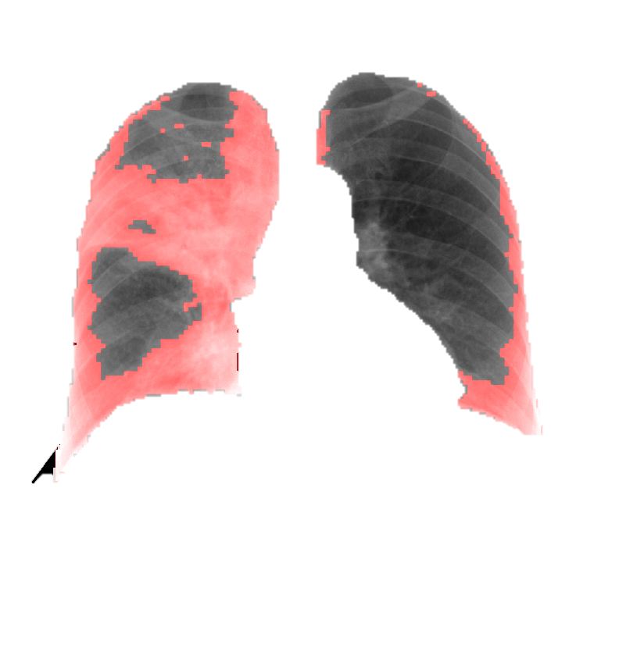
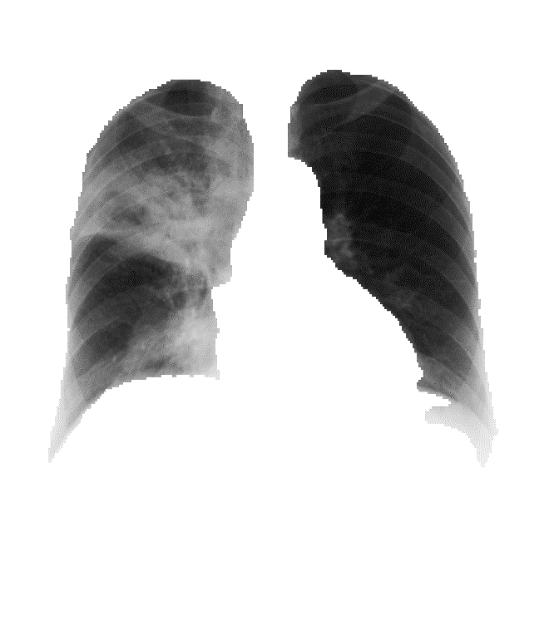
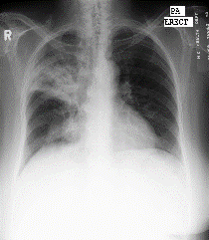
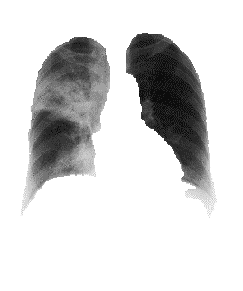
Machine Learning (ML): Unsupervised Learning
Input CXR image
Normal Patches Abnormal Patches
Performance Evaluation
Segmented Lung Fields
Extracting Image Patches
Image Patch Clustering
Patch Mapping on CXR images

Slide 20
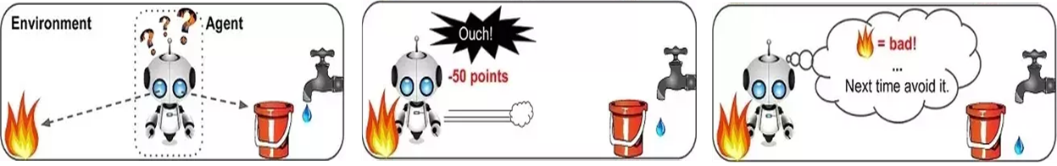
Machine Learning (ML): Reinforcement Learning
Reinforcement Learning
Examples
Markov Decision Process
Q Learning

Slide 21
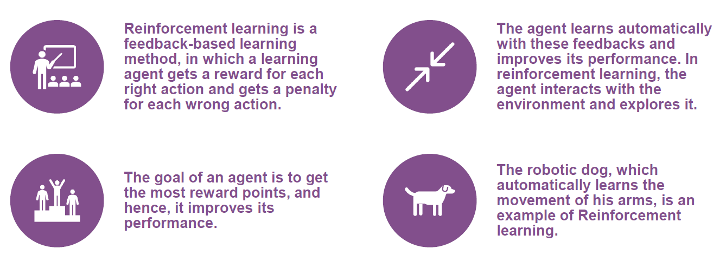
Machine Learning (ML): Reinforcement Learning

Slide 22
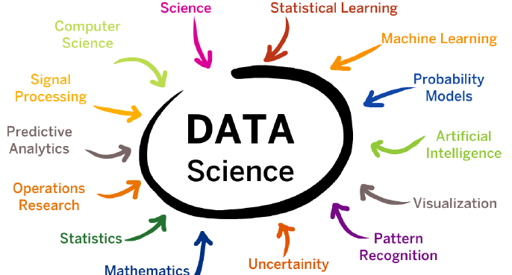
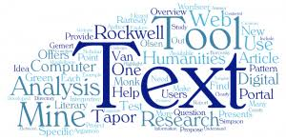
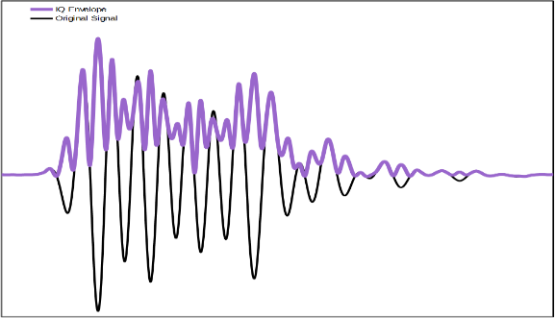
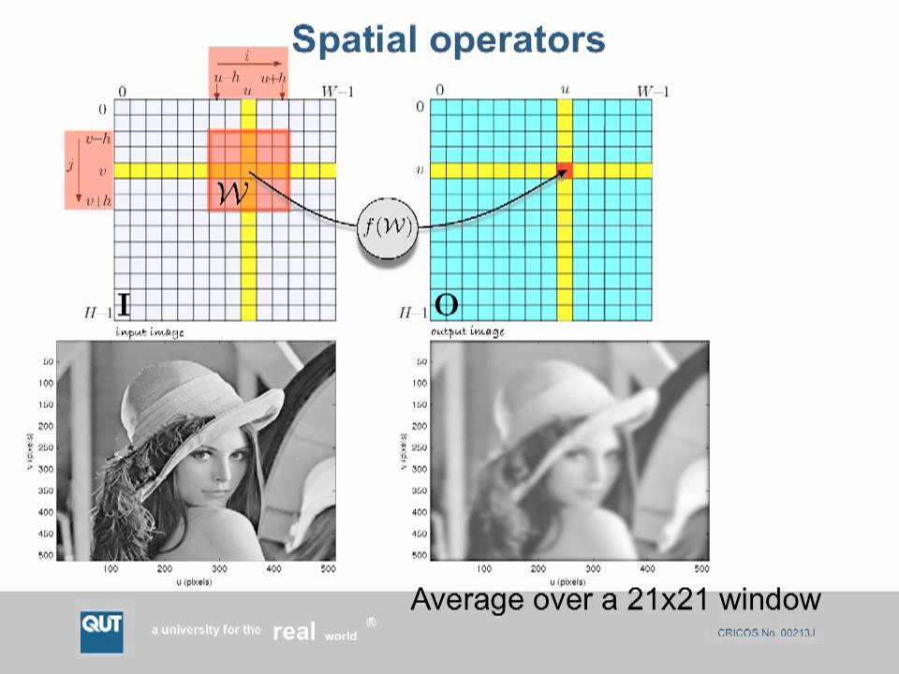
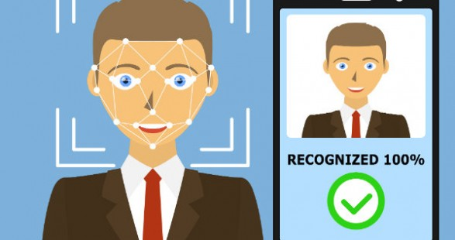
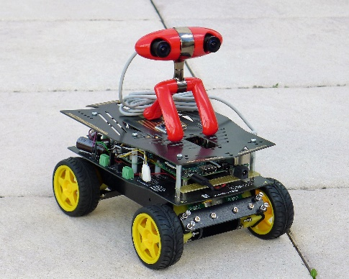
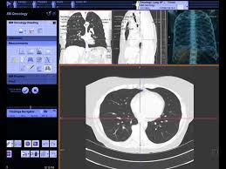
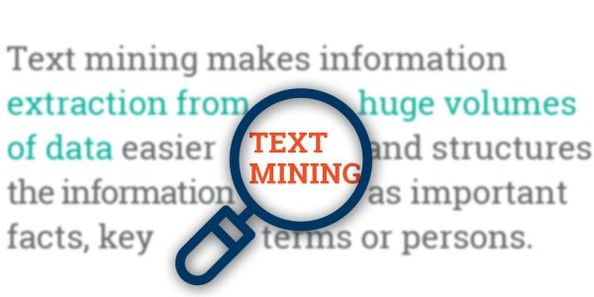
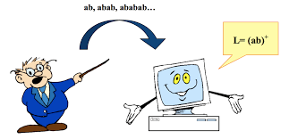
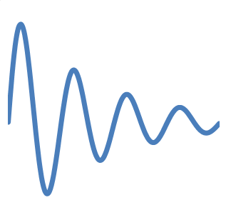
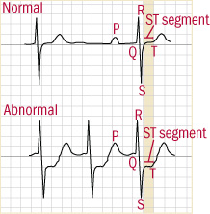
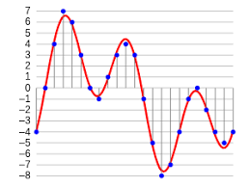
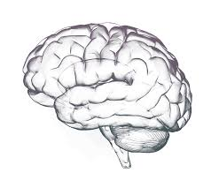
Machine Learning Domains
Text Domain
Signal Domain
Image Domain
Data Science
Machine learning in image domain has several applications like:
Machine is trained to analyze the signals from various sources like:
Machine learning in text domain has several applications like:
Facial Recognition/ Robotic Navigation Disease Detection
Object Detection
Brain (EEG) Heart (ECG) Audio signals
Text Mining Natural Language Processing

Slide 23
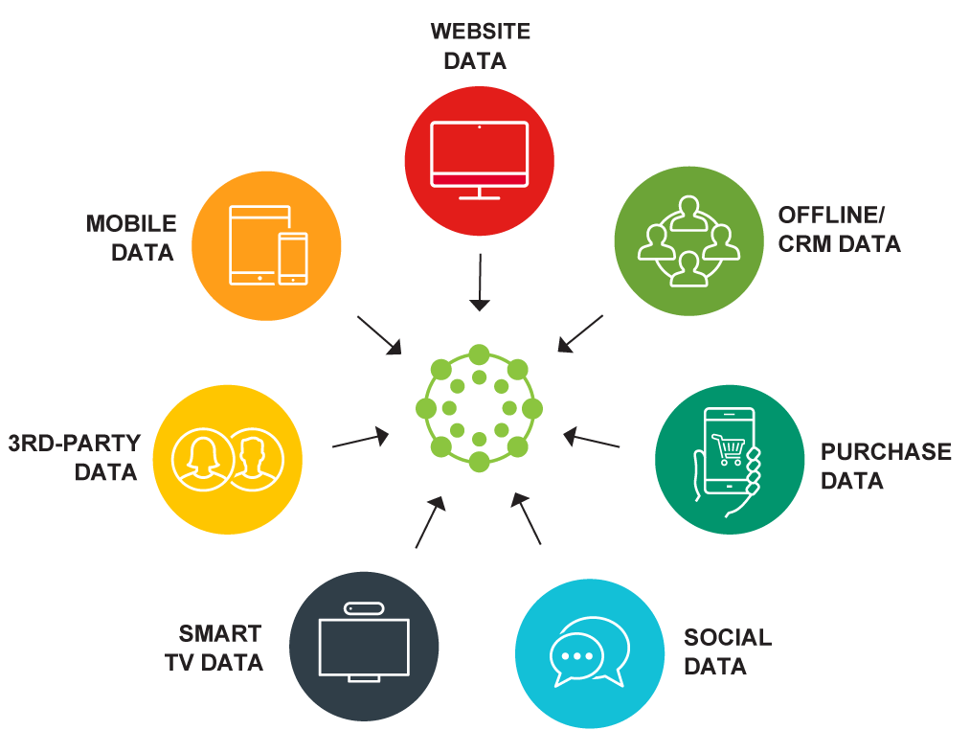
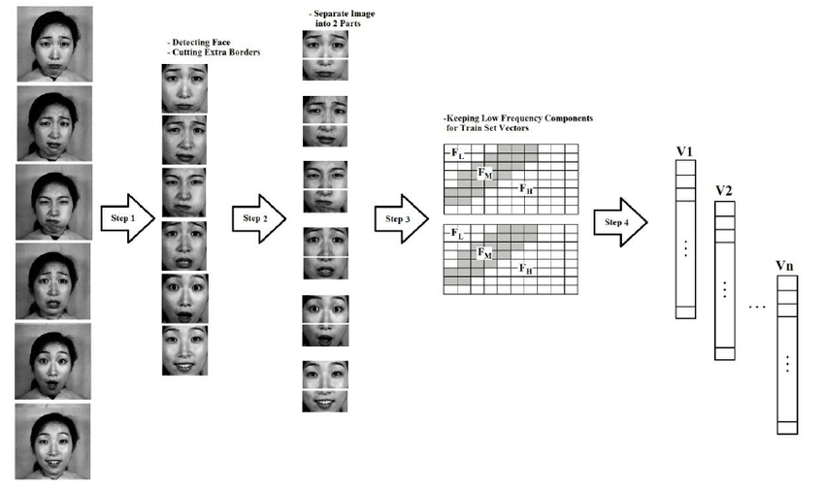
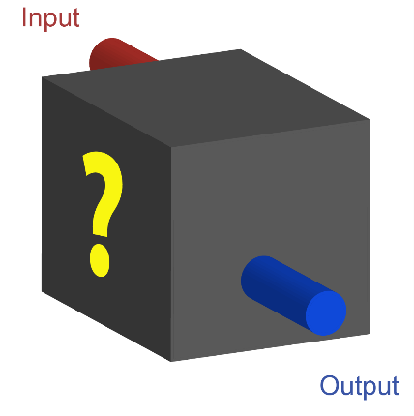
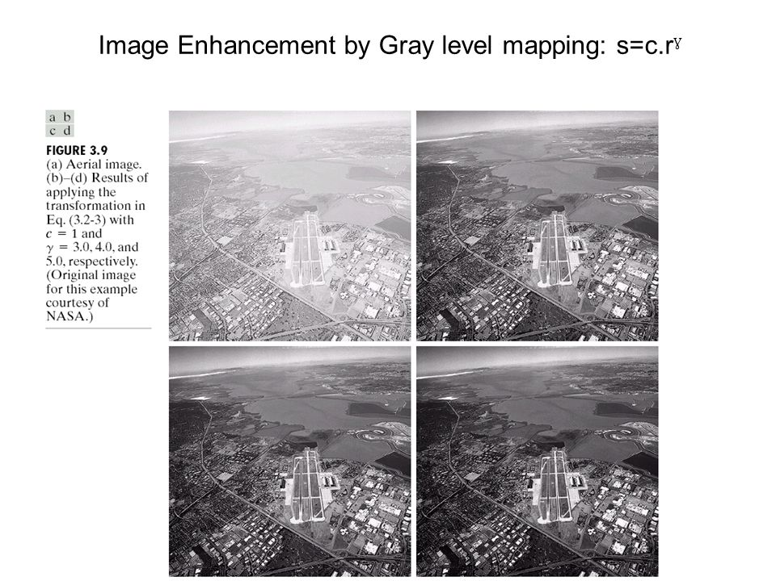
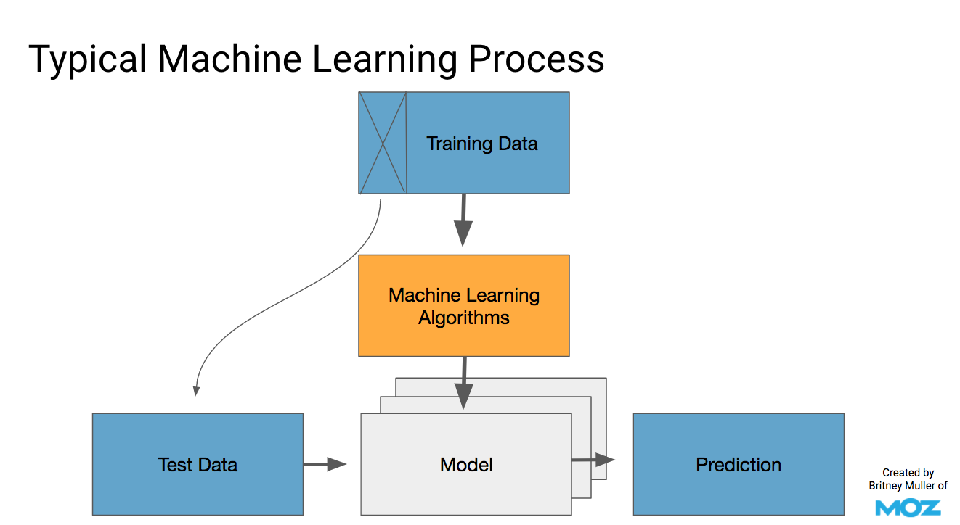
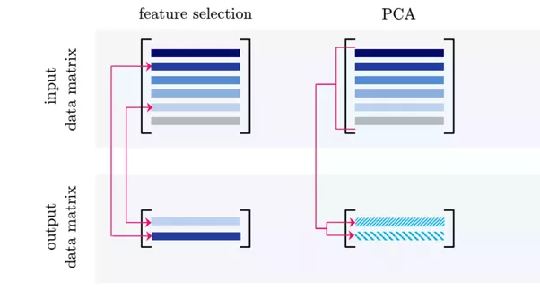
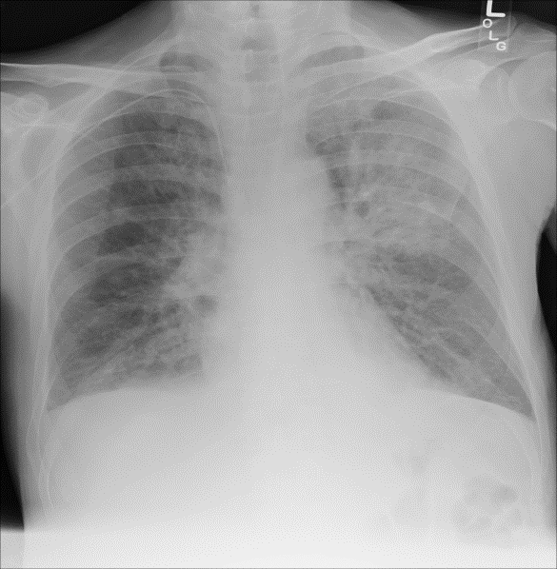
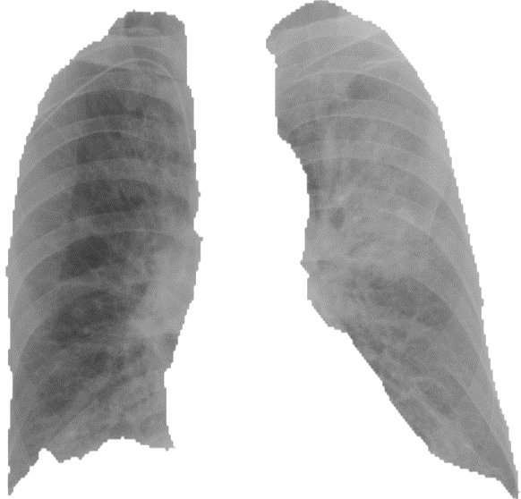
Machine Learning Process in image
Image Acquisition
Enhancement
Enhancement
(a) (b)
Segmentation
Segmentation
Feature Extraction
Feature Extraction
Feature Selection/
Reduction
Feature Selection/
Reduction
Classification
Figure 7. Classifying the features by training model [22]
Classification
Figure 8. Trained classification model
Figure 2. Image Acquisition from various sources [22]
Figure 3. (a) Image with low contrast [22] (b) Enhancement Image
Figure 6. Feature selection and reduction
Figure 4. (a) Complete chest X-Ray Image, (b) Segmented chest X-Ray Image
Use the Model
Figure 5. Extracting features from whole training image set [22]
Use the Model

Slide 24


Slide 25
















Machine Learning Applications
Virtual Personal Assistants
Analyze huge data
Health care sector
Others
Google Assistant
Weather Prediction
Automated disease diagnosis
Space exploration program
Personalized medicine
Google car
Cortana on Windows 10
Share market price
Smart Wearable's
Internet of Things
Jarvis
Earthquake/ Tsunami
Prediction

Slide 26

Machine Learning Applications

Slide 28
Further Readings:
Statistics, https://www.investopedia.com/terms/s/statistics.asp
Machine Learning, https://www.ibm.com/cloud/learn/machine-learning
What Is Machine Learning, https://www.expert.ai/blog/machine-learning-definition/
Getting started with Machine Learning, https://www.geeksforgeeks.org/getting-started-machine-learning/
Machine Learning- Sudeshna Sarkar, https://www.youtube.com/watch?v=T3PsRW6wZSY&list=PLJ5C_6qdAvBGaabKHmVbtryZW9KpICiHC

